Slide 1

Birla Vishvakarma Mahavidyalaya
4CP33 (PROJECT-IDP)
Convener : Prof. Mohsin I. Hasan
Internal Guides : Prof. Prashant B. Swadas,
Dr. Narendra M. Patel
External Guide : Manish Lakhara(Team Lead)
By : 19CP048 – Om Siddhapura

Slide 2

WebIMS

Slide 3
Content
Problem Statement
Problems
USA Healthcare Flow
Work before Mid1
Technologies Learned
Requirements
Practice Project

Slide 4
Problem Statement
Designing a web application that makes it simple for doctors and staff to manage patient’s data and strengthen patient experience. The tool aids doctors and related staff in managing the patient’s electronic data with full convenience

Slide 5
What Are The Problems?

Slide 6
Healthcare Flow
HIPAA Act
Tedious task to maintain and store EHR

Slide 7
USA Healthcare Flow

Slide 8
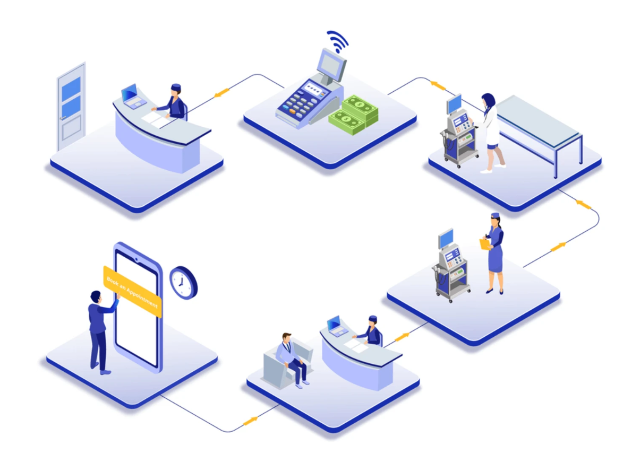
Appointment Booking
Check In
Meeting with MA
Meeting with Healthcare provider
Medication
Billing

Slide 9
Mid1

Slide 10
Company Overview Training
Technology learning
Requirement gathering for main project
Practice Project (todo app)

Slide 11
Technologies learned

Slide 12




HTML
Java script
CSS
Angular

Slide 13
Requirements

Slide 14
Functional Requirements
User can create or update patient data.
User can view patient data like demographics, vitals, allergies, etc.
Soft delete patient data.
Create and Update patient contacts
Nonfunctional Requirements
Our web application is supported by all web browsers.
Our web application is following all rules and regulation of HIPAA act.

Slide 15
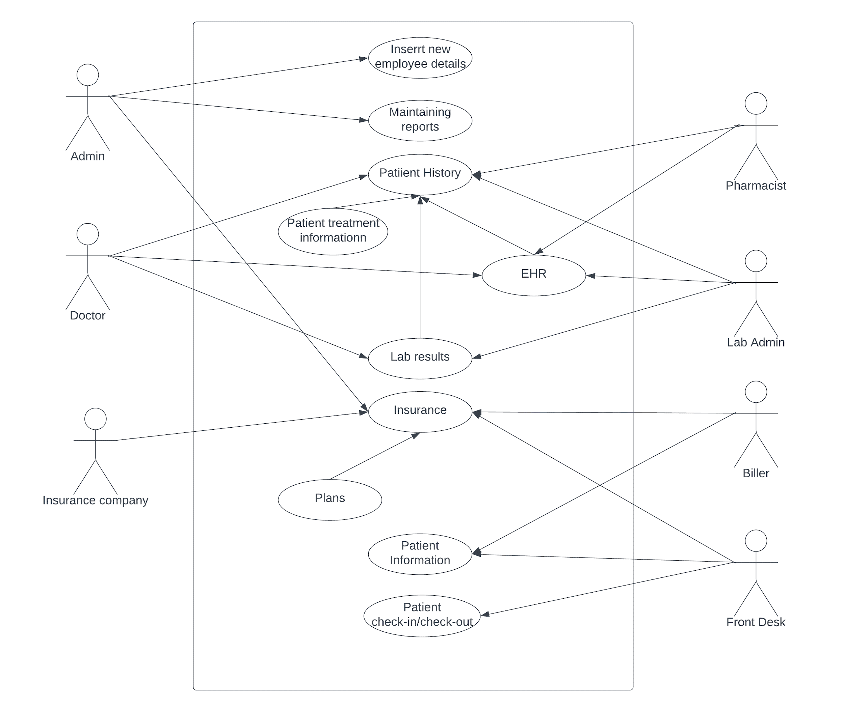
Usecase Diagram

Slide 16
Practice Project todoApp

Slide 17
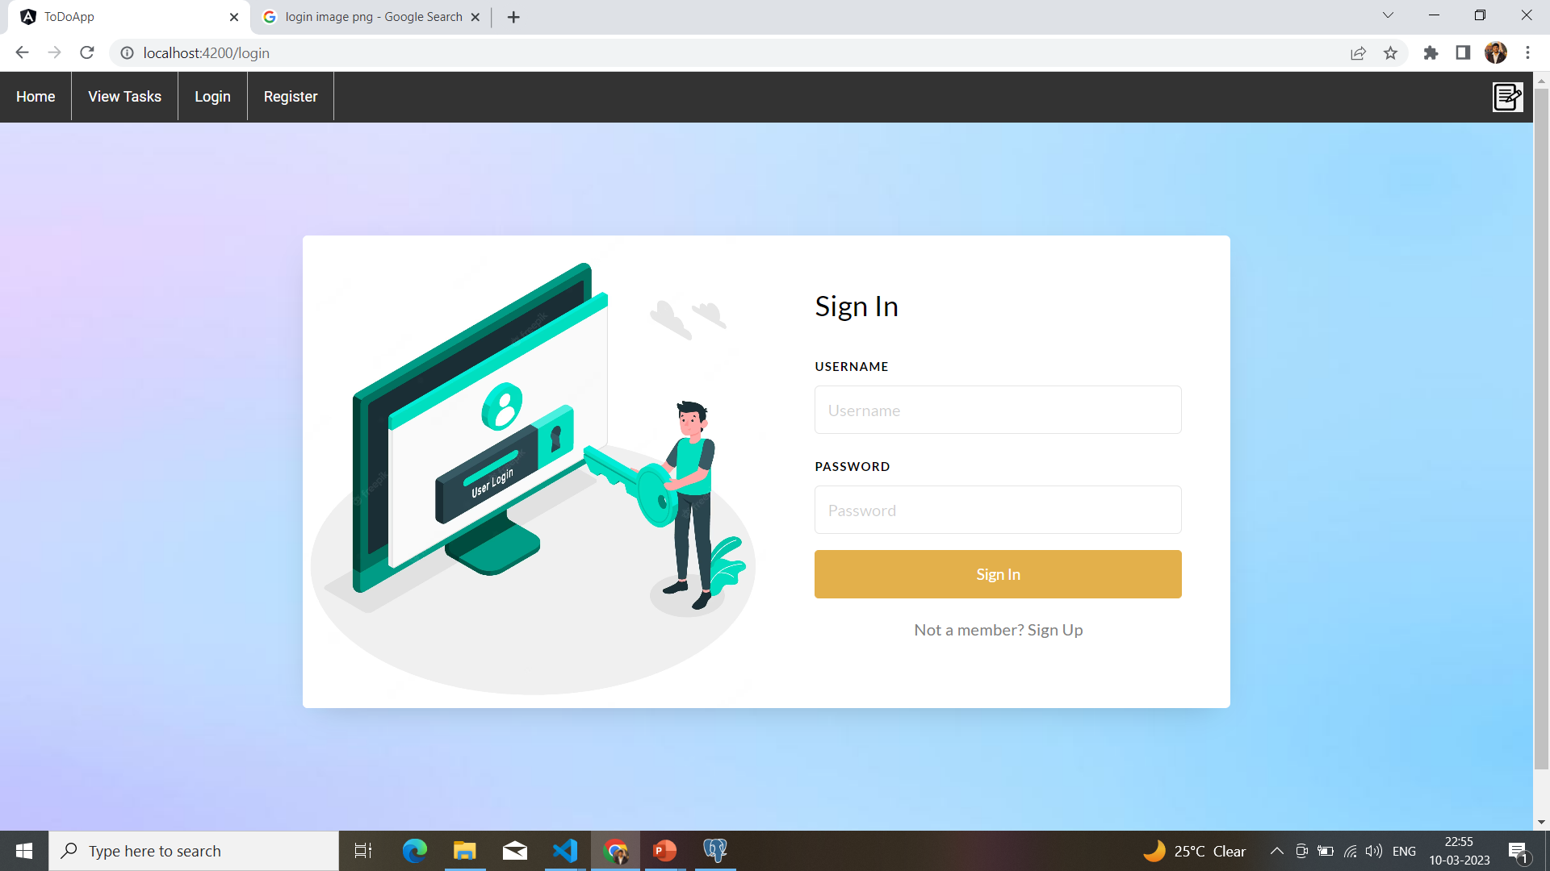
Sign In

Slide 18
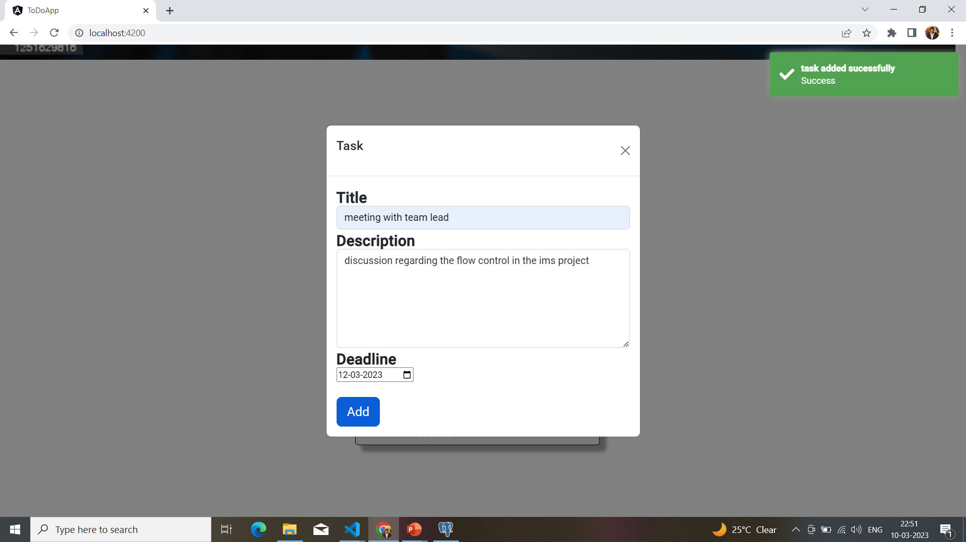
Add Task

Slide 19
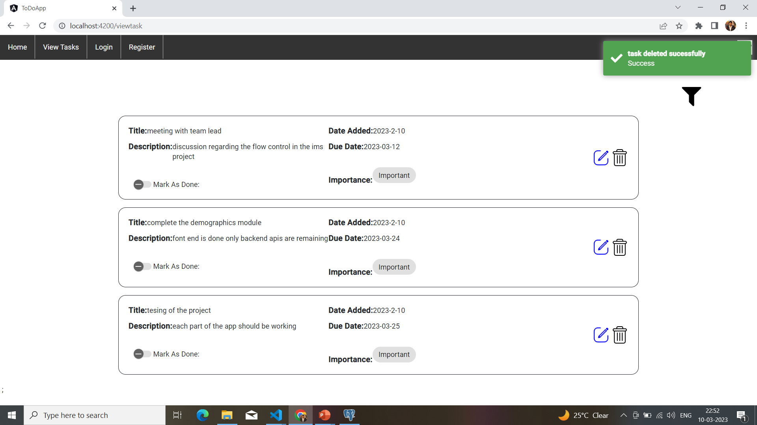
Delete Task

Slide 20
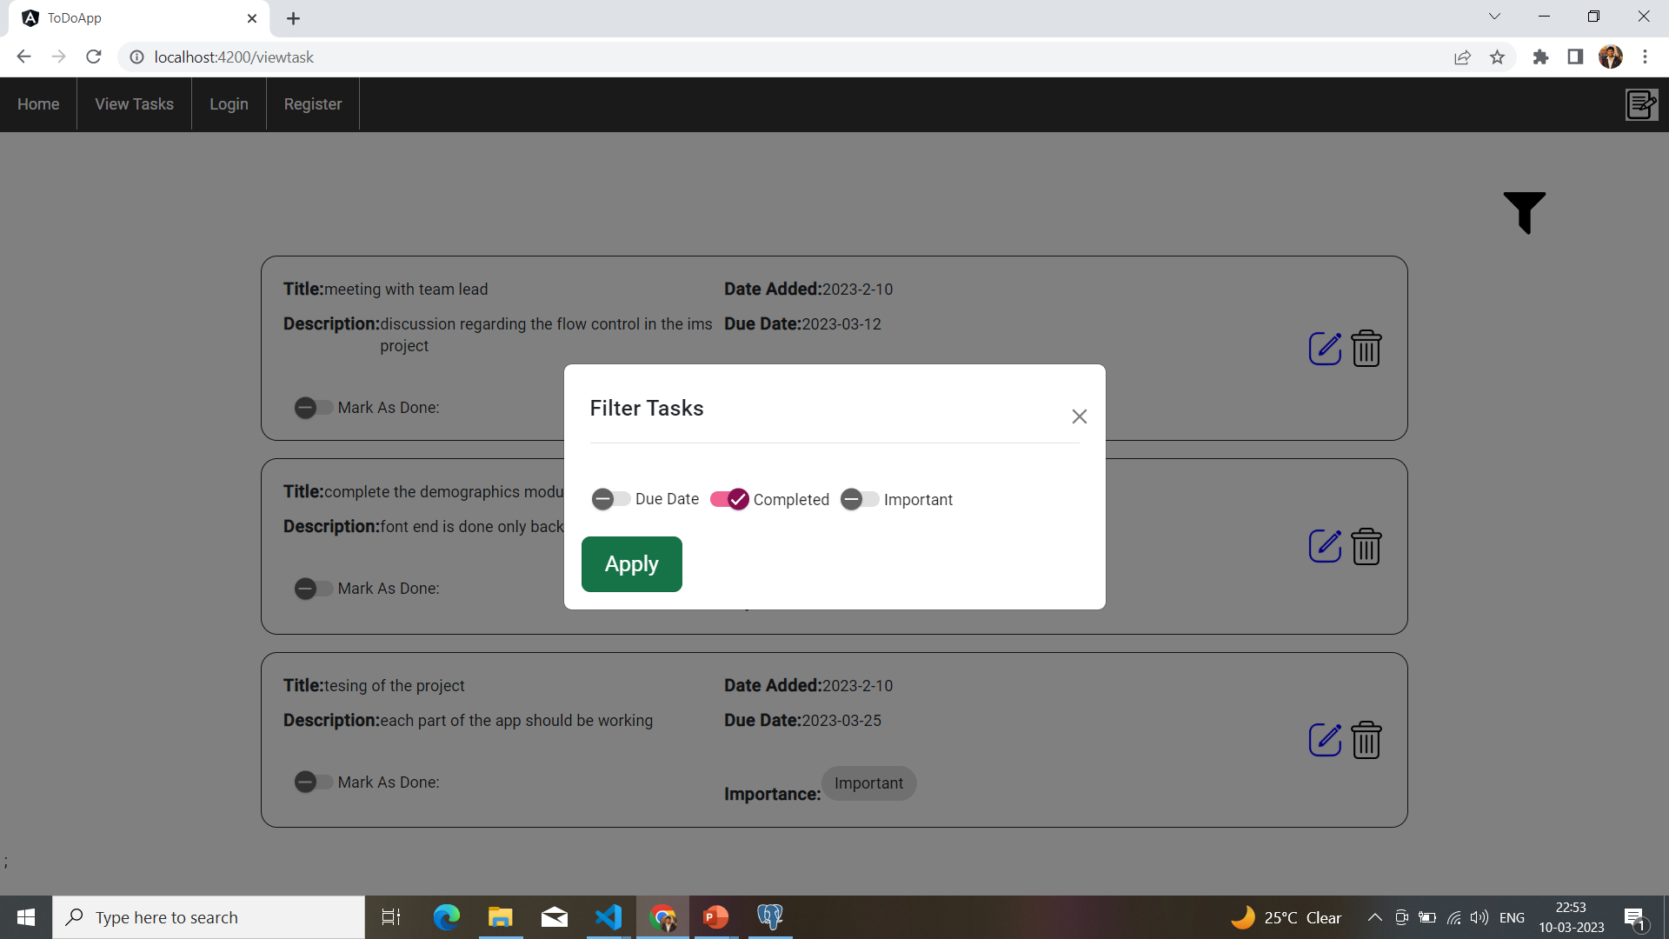
Filter to Tasks

Slide 21
Mid 2

Slide 22
Front-End

Slide 23
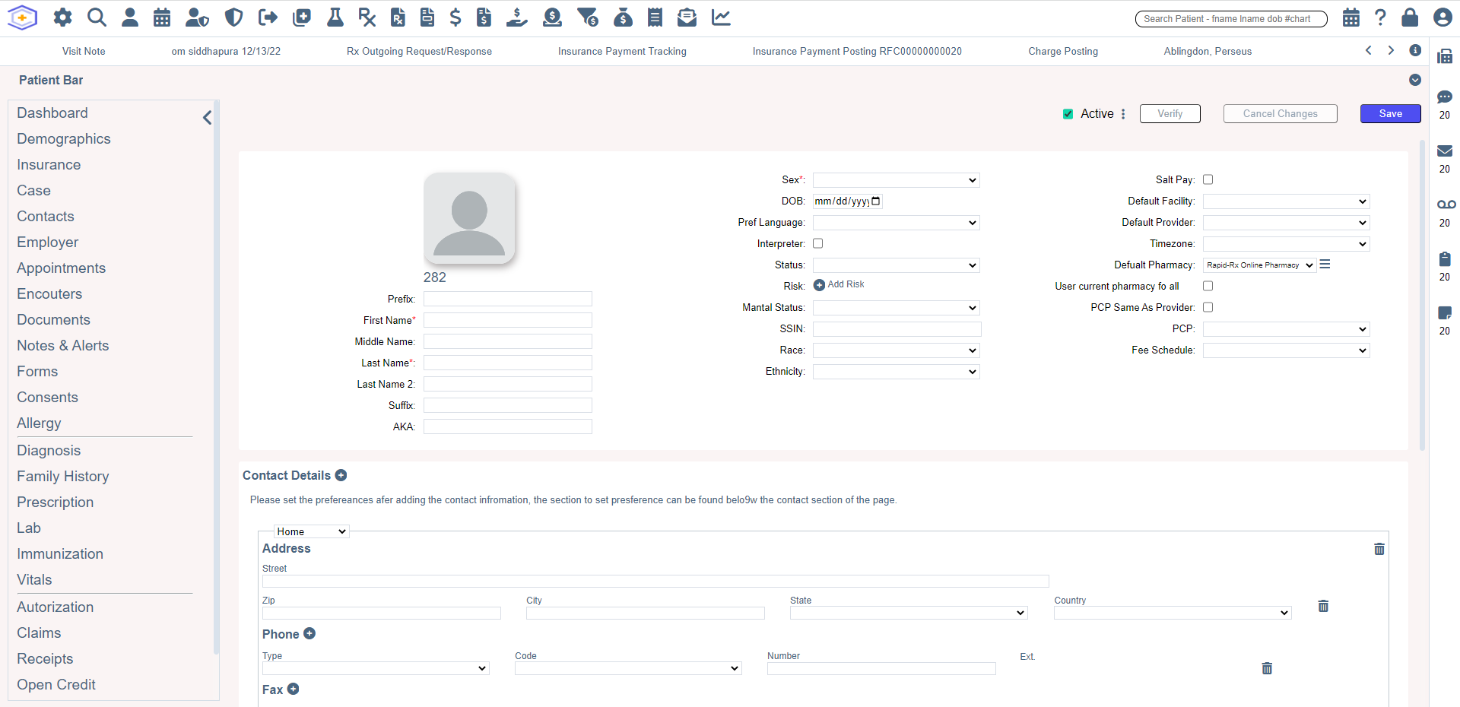
Demographics Page

Slide 24
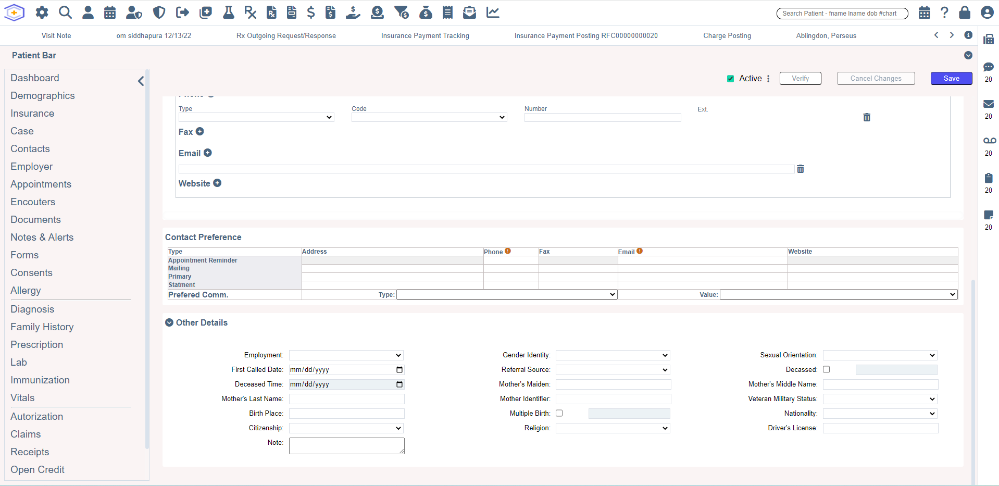

Slide 25
Back-End

Slide 26
Task1

Slide 27
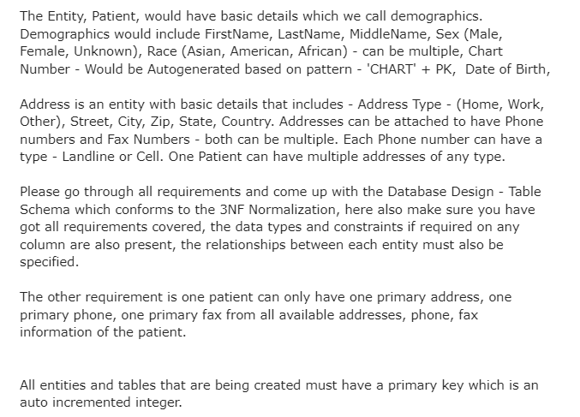
Requirement

Slide 28
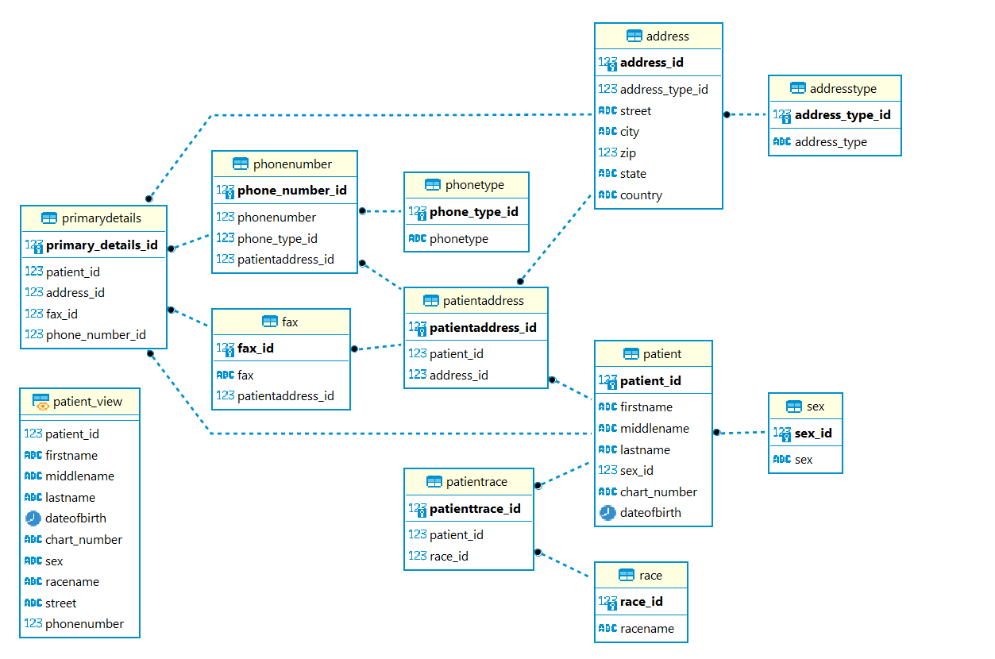
ER Diagram

Slide 29
Task 2

Slide 30
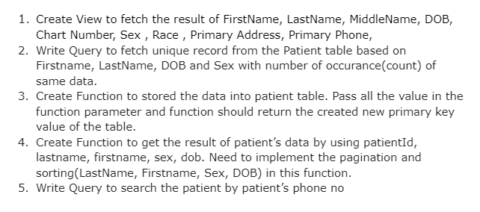
Requirement

Slide 31
APIs

Slide 32
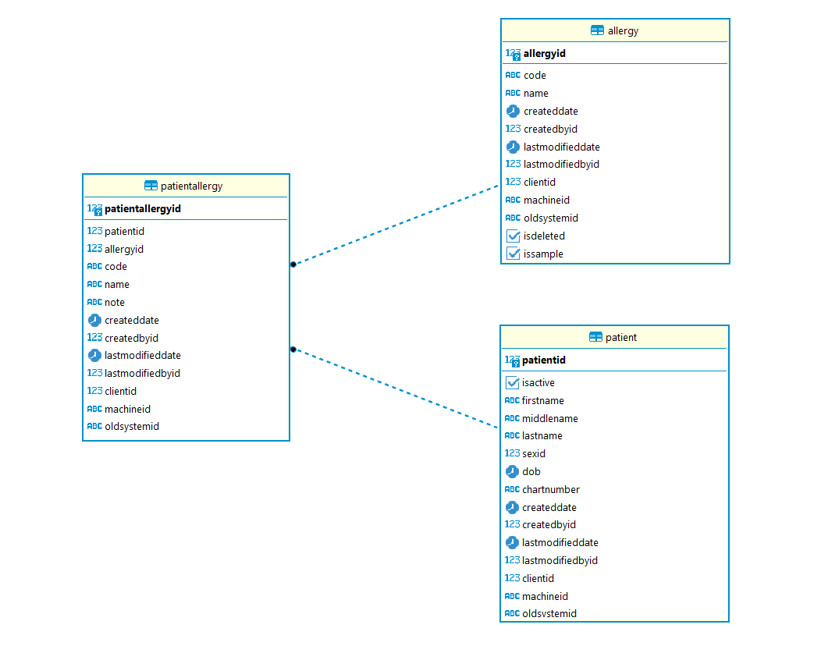
Table Access for APIs

Slide 33
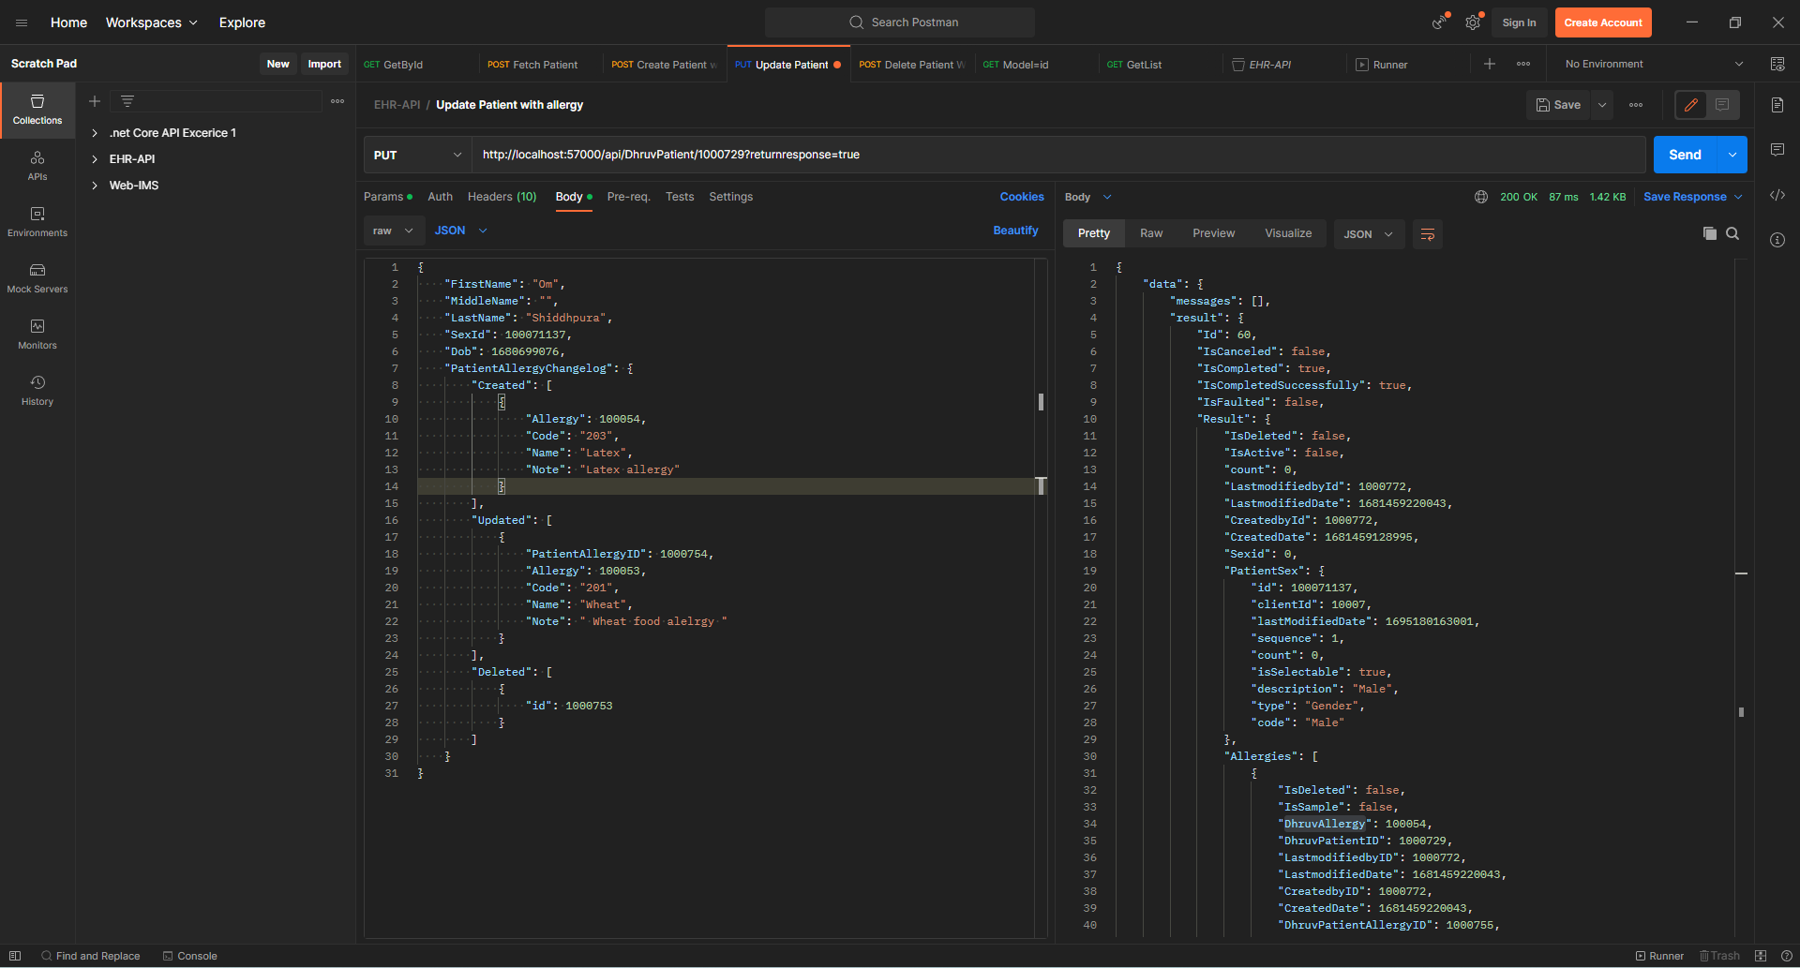
Update Patient with allergy

Slide 34
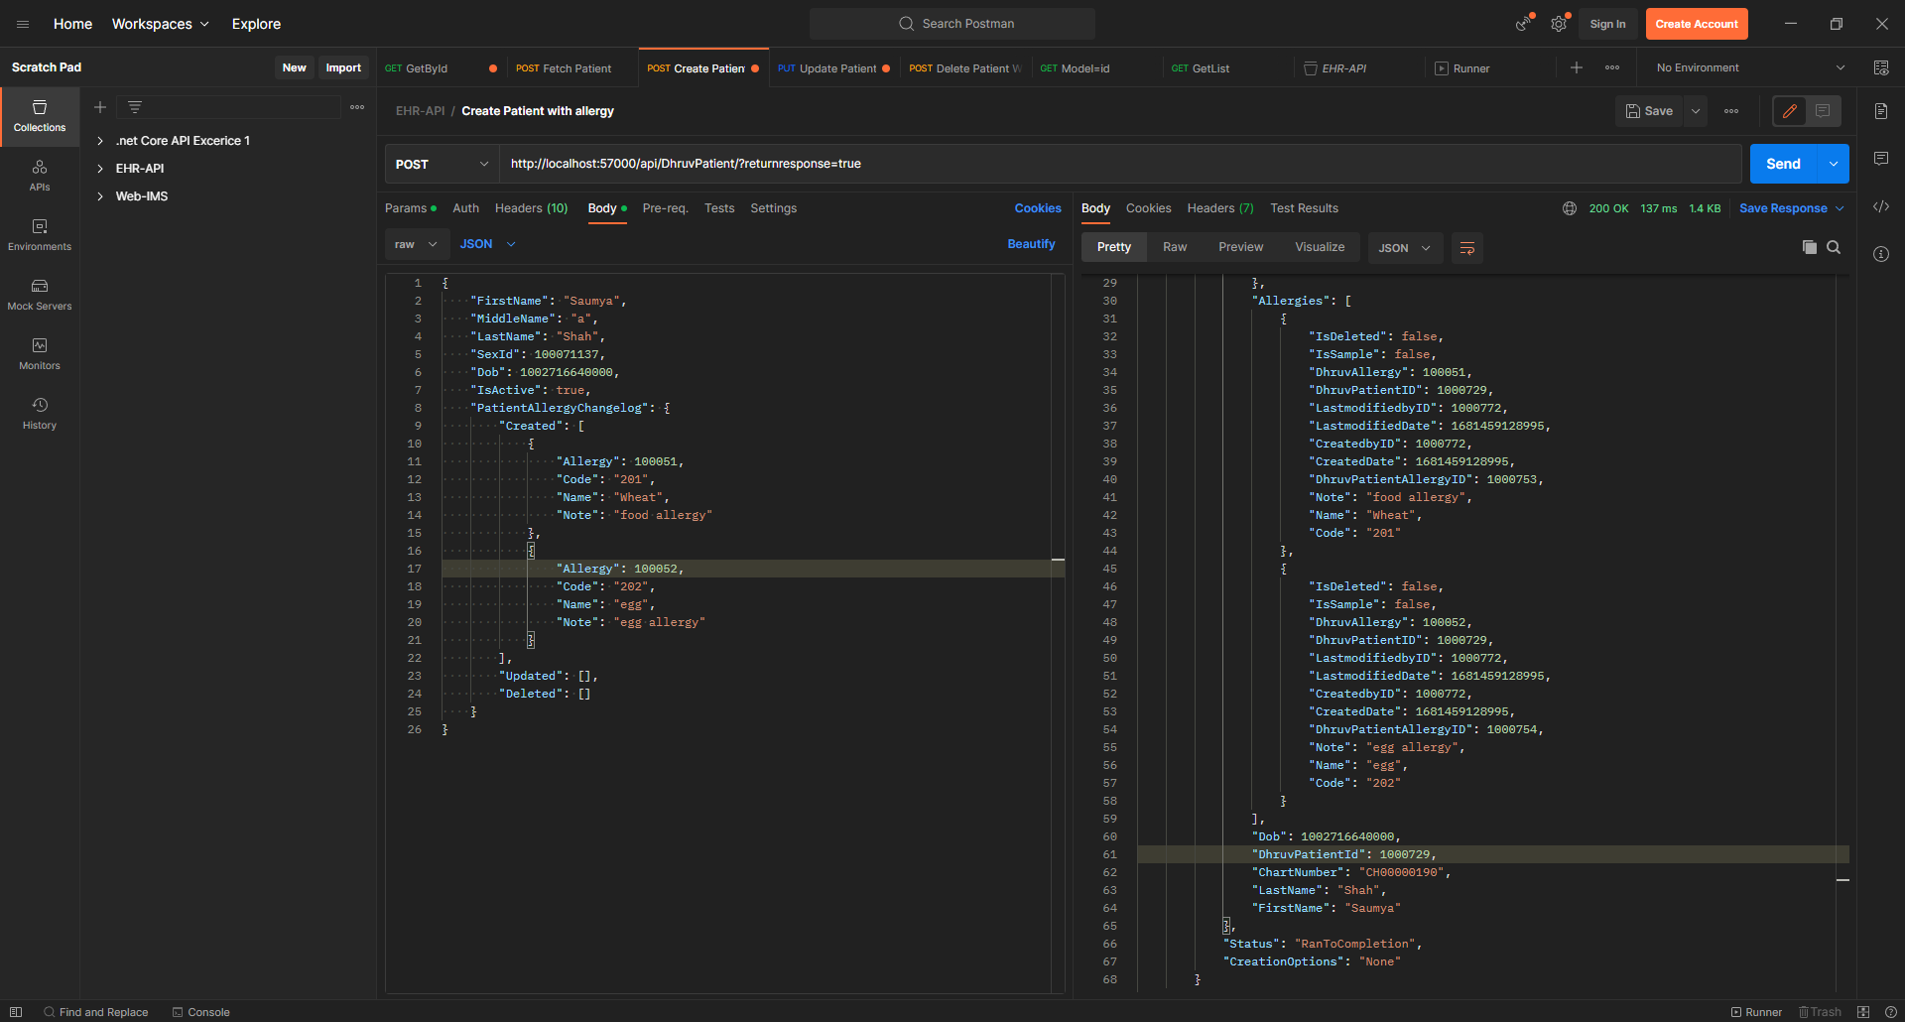
Create Patient with allergy

Slide 35
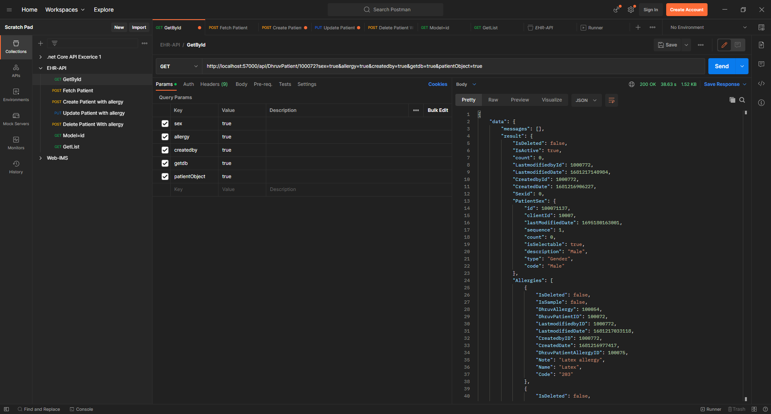
Get Data by ID

Slide 36
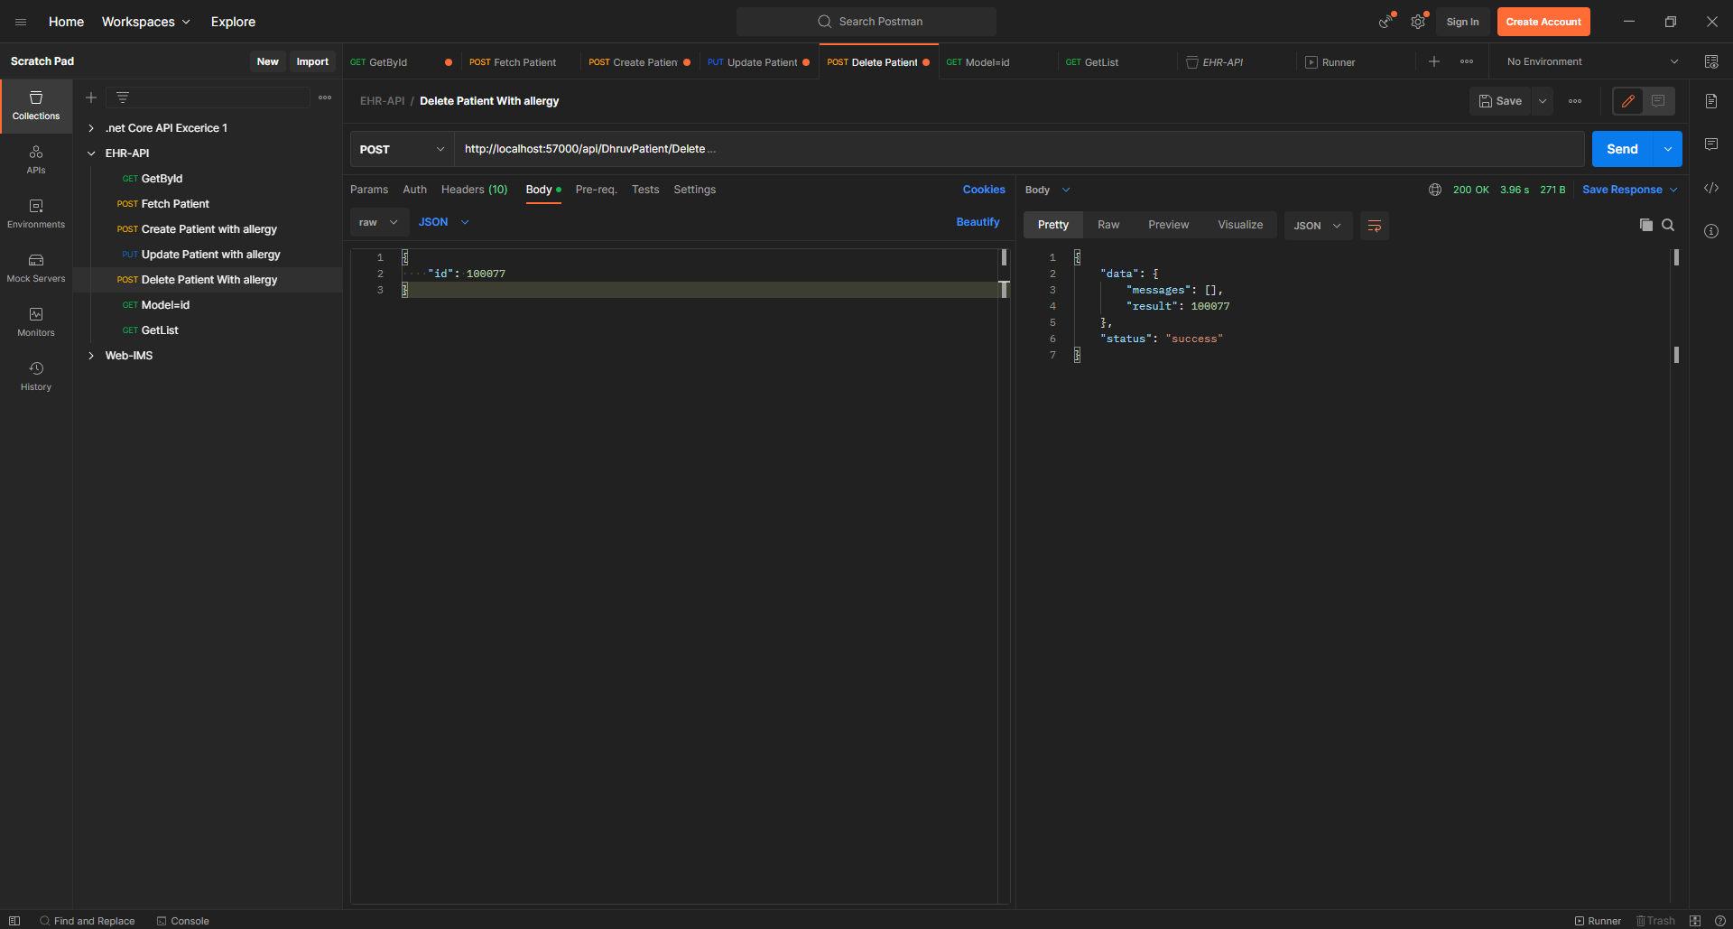
Delete Patient with allergy

Slide 37
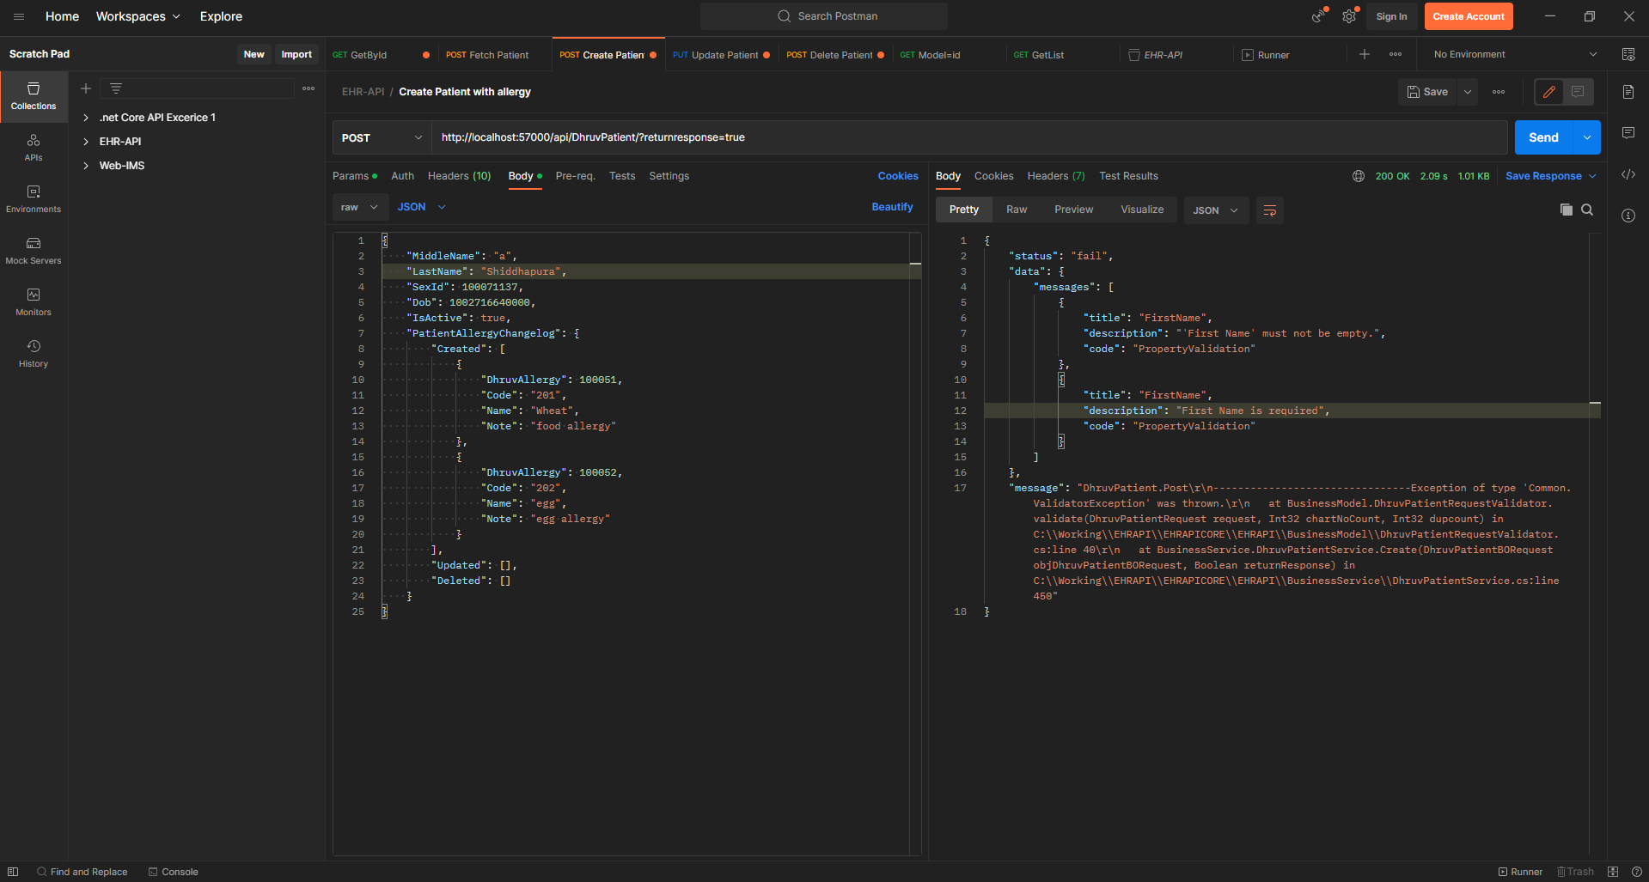
Error Handling

Slide 38
Practice Project Medicine Reminder

Slide 39
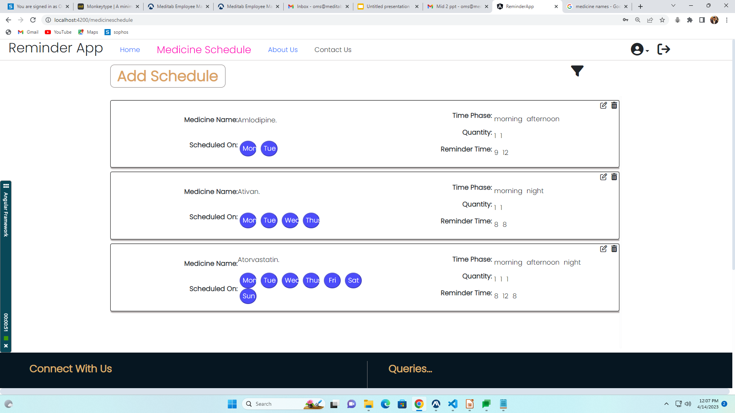
Medicine Schedule Page

Slide 40
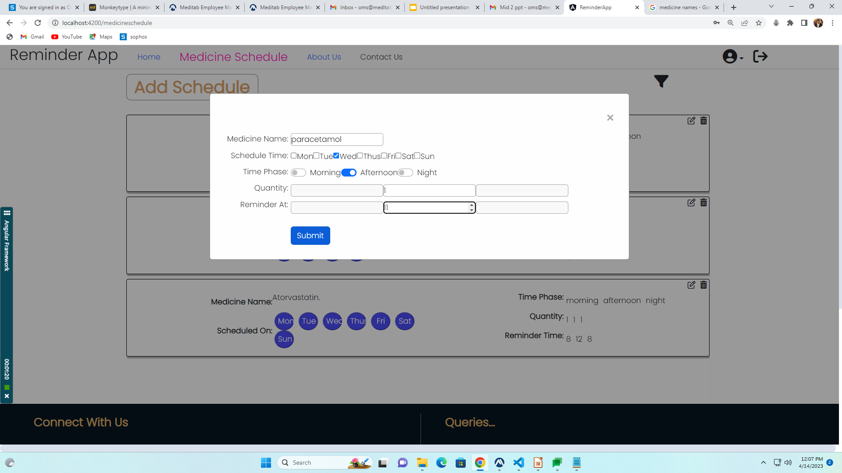
Add Schedule

Slide 41
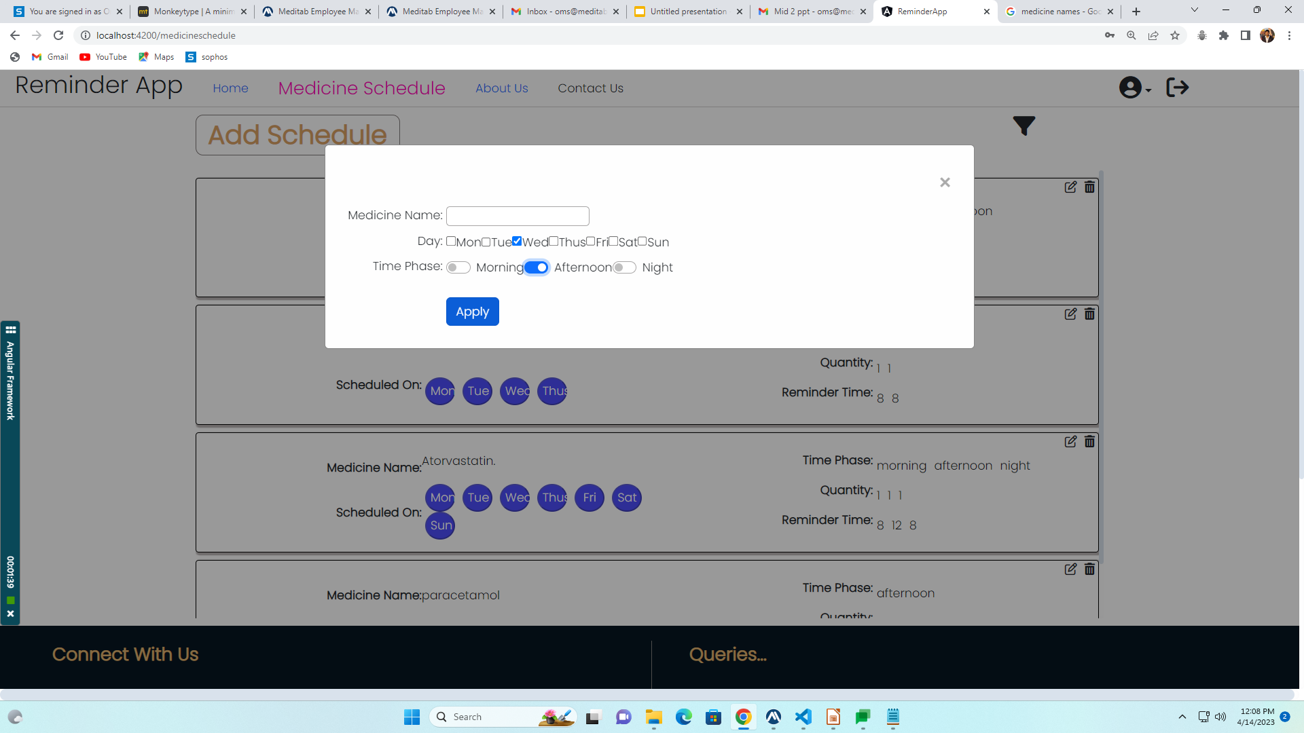
Filter Schedule

Slide 42
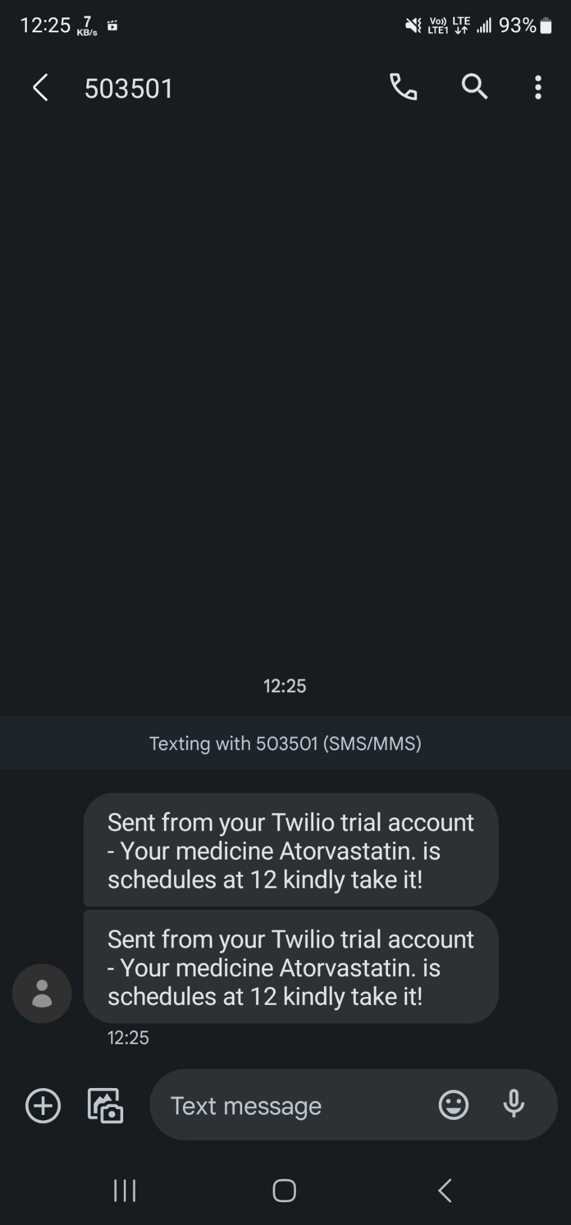
SMS for Medicine

Slide 43
Future Work
Making API for
User can view patient data like demographics, vitals, allergies, etc.
Connecting API with Frontend
Create and Update patient contacts

Slide 44
References
Html (tutorial)
https://www.w3schools.com/html/
Css
https://www.w3schools.com/css/default.asp
Java Script
https://www.youtube.com/watch?v=ER9SspLe4Hg&list=PLu0W_ 9lII9ahR1blWXxgSlL4y9iQBnLpR
Angular
https://www.youtube.com/@codestepbystep
Angular libraries
https://ng-bootstrap.github.io/#/home
https://material.angular.io/

Slide 45
THANK YOU

